Slide 1
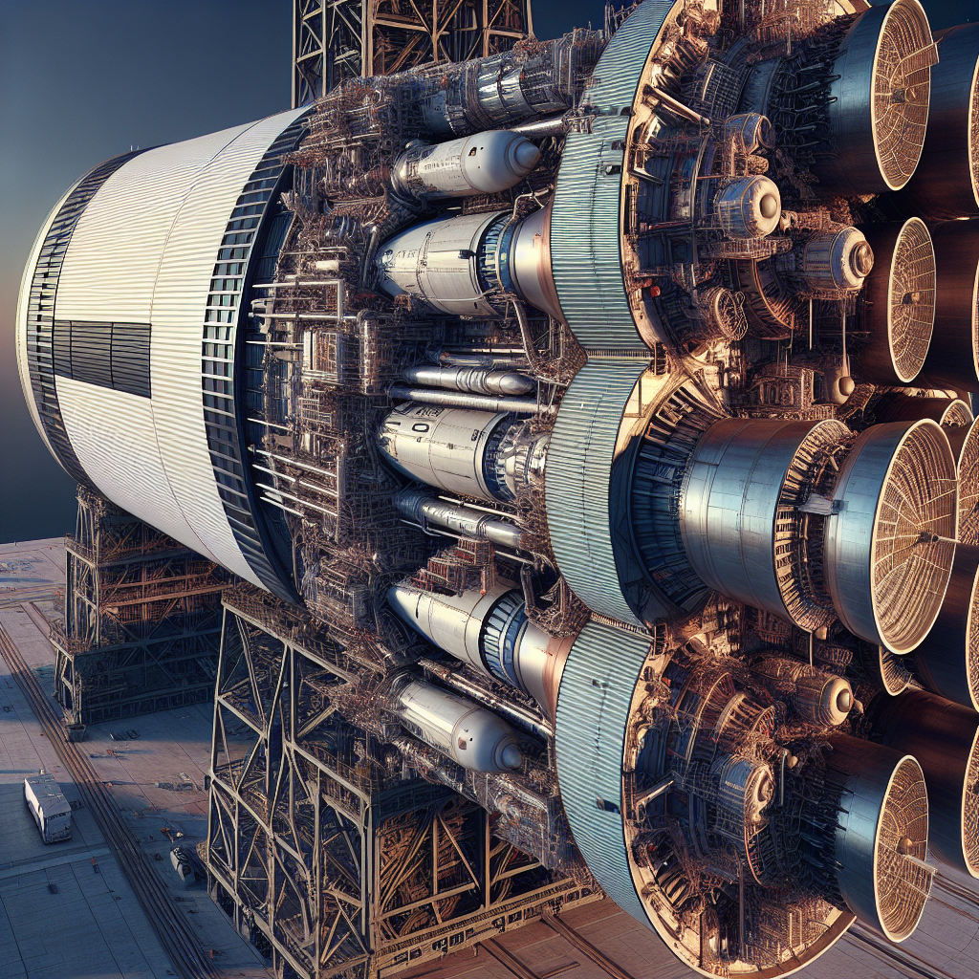
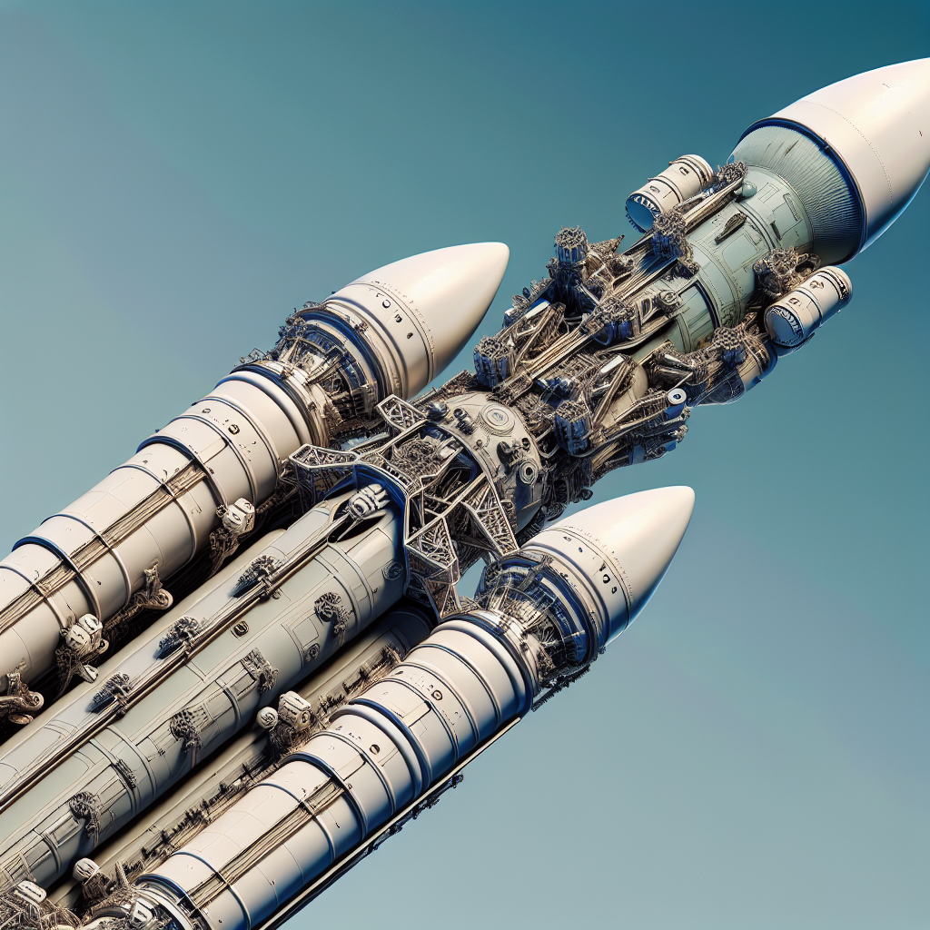
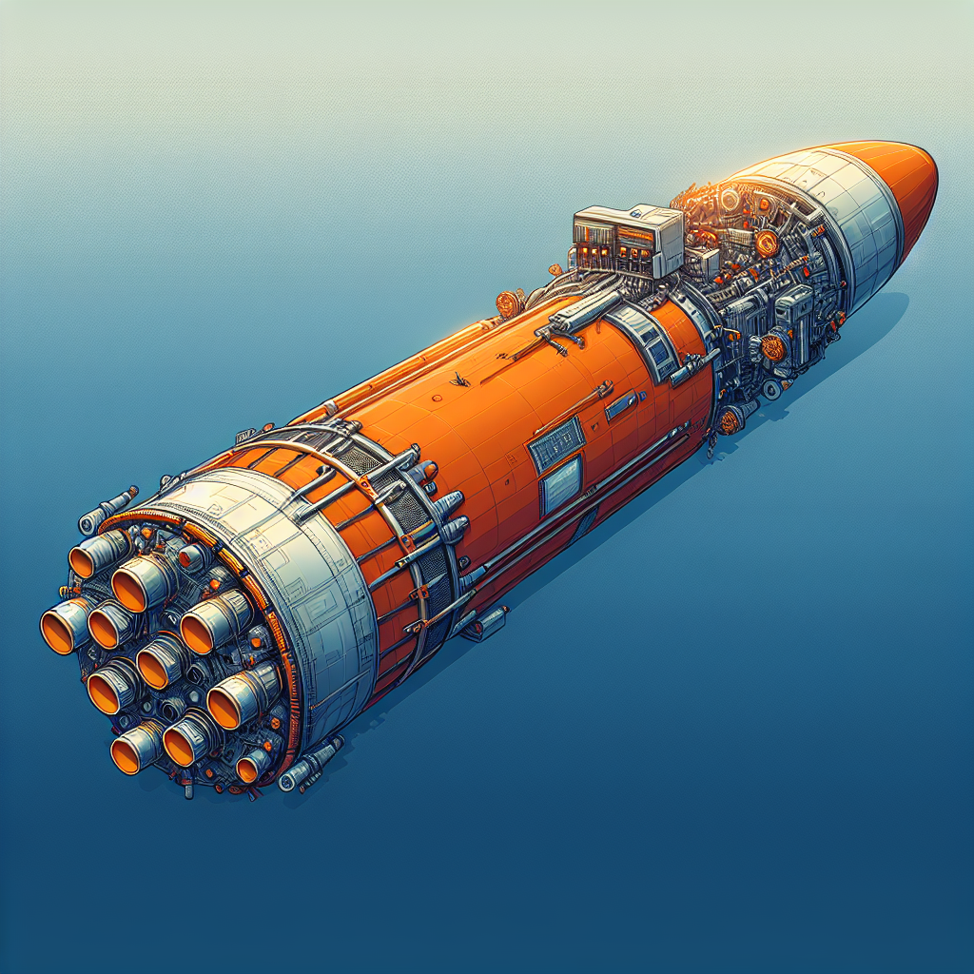

Vehicle Evolution: Saturn V → SLS/Orion (with Starship Context)
System | Era | To LEO Tons | To TLI Tons | Notes
Saturn V + Apollo CSM/LM | 1967–1973 | ~140 | ~48 | Expendable; three-stage kerolox/hypergolic; Moon landings via LM.
SLS Block 1 + Orion | Artemis I–III | ~95 | ~27 | Expendable; RS‑25 + 5‑segment SRBs; Orion for deep-space crew.
SLS Block 1B + Orion | Artemis IV+ | ~105 | ~38–42 | EUS upper stage; Gateway and larger payloads.
Starship (HLS variant) | Artemis III+ (provider) | 100–150 (reusable, target) | ≥100 (with on-orbit refueling) | Fully reusable; lunar lander under NASA contract.
Saturn V LEO: 140
Saturn V TLI: 48
SLS Block 1 LEO: 95
SLS Block 1 TLI: 27
SLS Block 1B LEO: 105
SLS Block 1B TLI: 40
Starship LEO: 125
Starship TLI: 100

